Slide 1

Department of Computer Science & Engineering
Artificial Intelligence & Machine Learning
A. P. Shah Institute of Technology
G. B. Road, Kasarvadavali, Thane (W) - 400 615
UNIVERSITY OF MUMBAI
Academic Year 2024 - 25

Slide 2

Team
Bhushan Khopkar (22106099),
Saif Khan (22106072) &
Devansh Mane (22106062)
Guided By-
Prof. Viki T. Patil

Slide 3
Static Website

Slide 4

Static Website using Docker
Problem Statement
Manual deployment of static websites can be time-consuming and inconsistent. This project uses Docker to containerize and serve a static website, ensuring easy setup, consistent performance, and platform independence. The site runs in a lightweight container with Nginx, making deployment simple and repeatable without external dependencies.

Slide 5
Objective
The objective of this project is to develop and deploy a static website using Docker, enabling consistent performance across various environments. By containerizing the website with Nginx, the project ensures fast, reliable access without backend dependencies. This approach promotes portability, simplifies deployment, and demonstrates efficient use of container technology for hosting lightweight web applications.

Slide 6

Frontend: HTML, CSS, JavaScript
Hosting and Deployment: Docker
Tech Stack

Slide 7
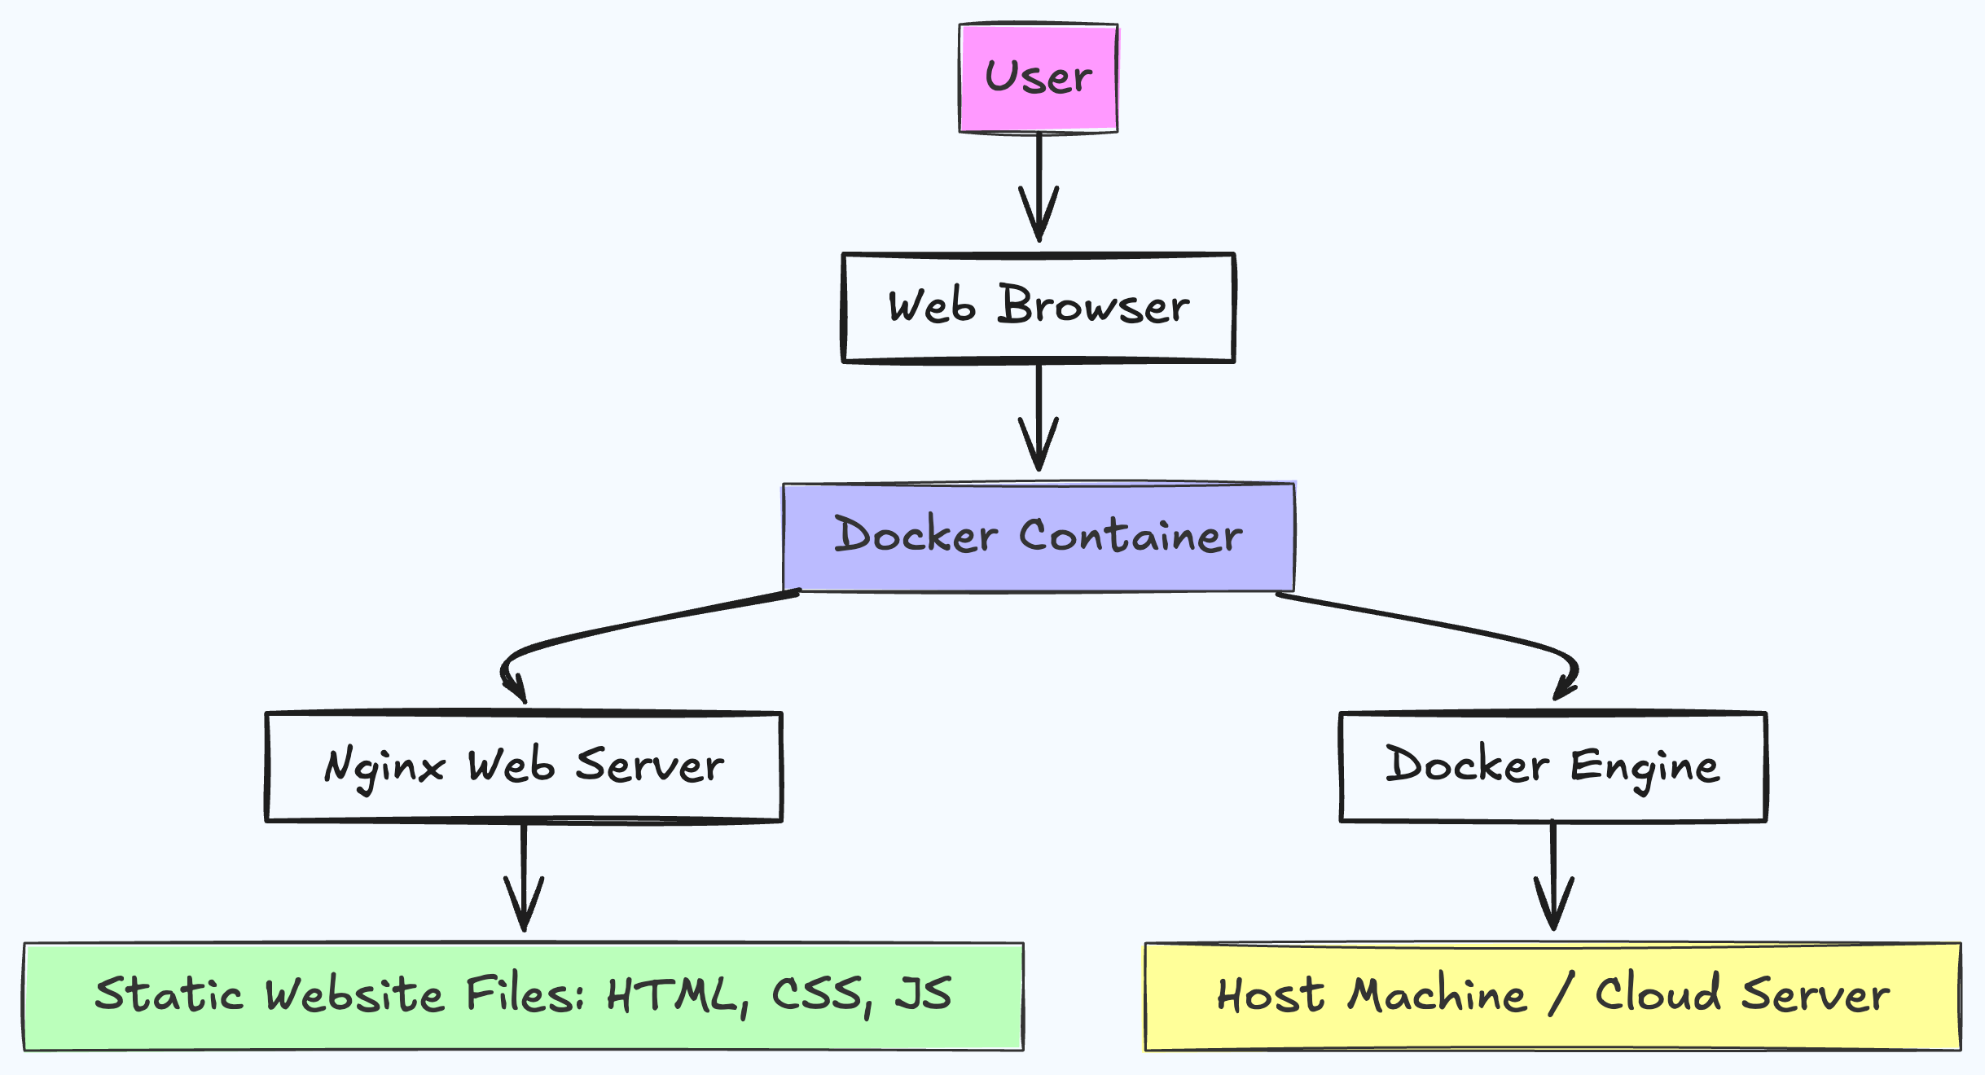
Block Diagram

Slide 8
Conclusion
This project offers a lightweight and portable solution for hosting static websites using Docker, ensuring consistent deployment across environments. By combining frontend technologies (HTML, CSS, JavaScript) with a Dockerized Nginx server, the website runs efficiently without backend dependencies. The use of containers simplifies setup, enhances portability, and streamlines updates, making it an ideal approach for developers and teams seeking reliable and scalable web hosting solutions.

Slide 9
Thank you!
Have
a good weekend!

